Slide 1
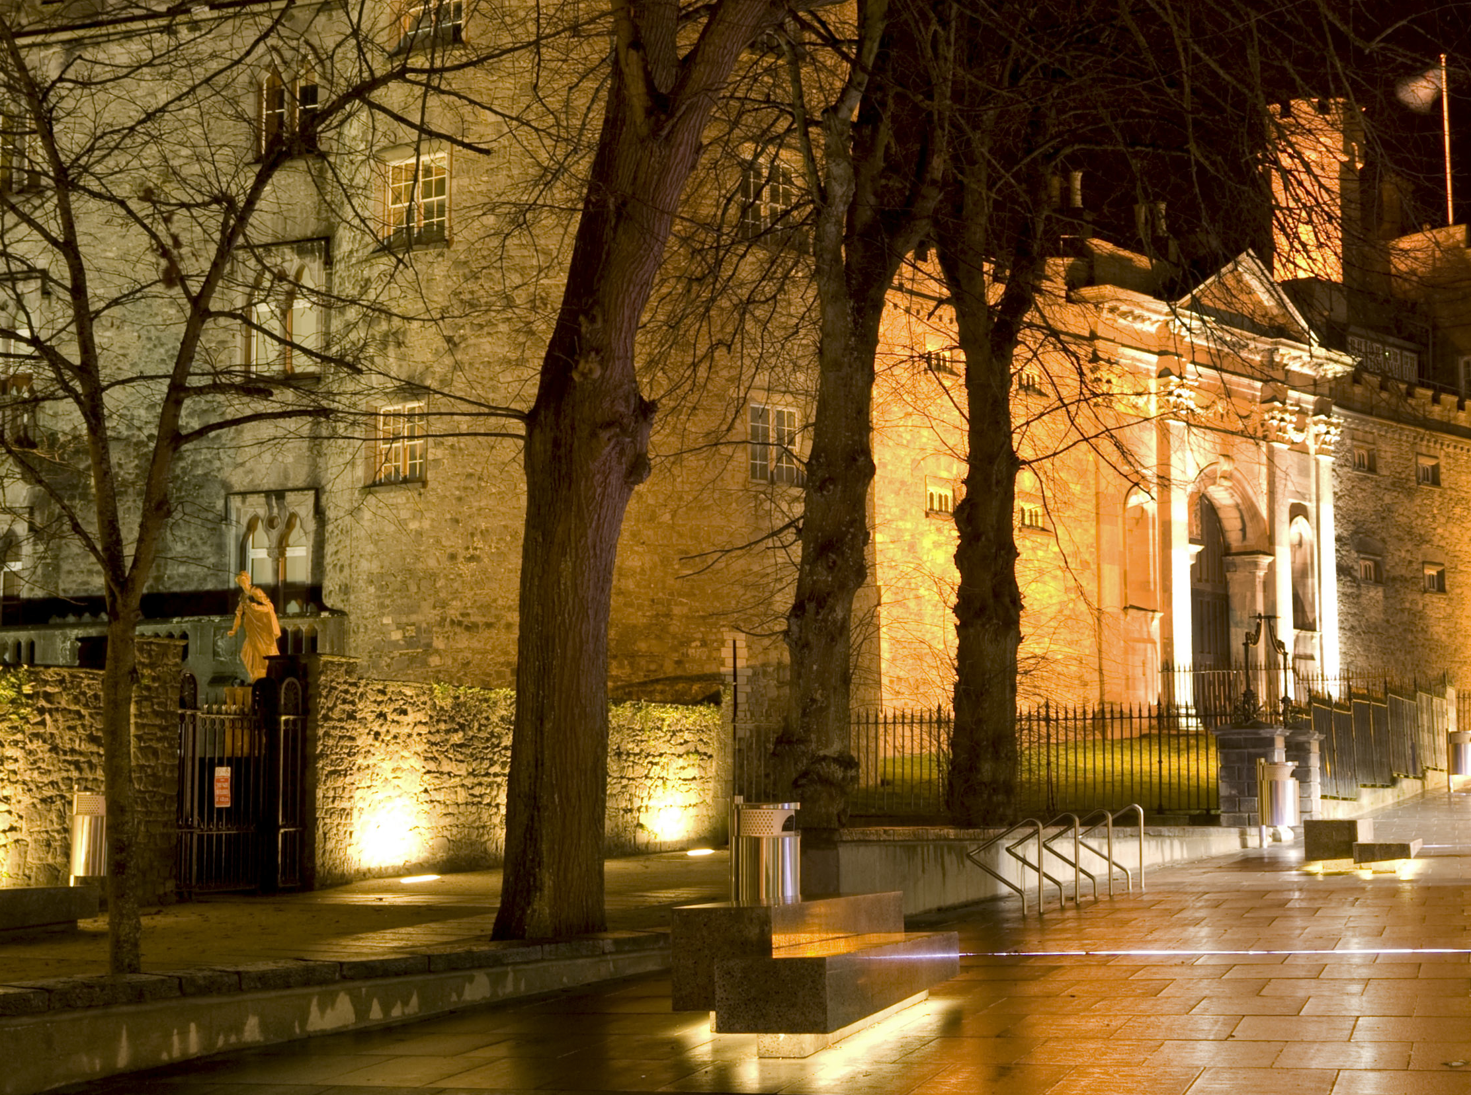

INTRODUCTION
“In the quest for sustainable living
the most significant challenge in architecture
lies in addressing urban problems.
The crisis requires a paradigm shift.”
(Rotterdam International Biennale)

Slide 2
INTRODUCTION
“Waterfront regeneration is the best global example
of the resilience of cities…
of their ability to adapt to changed circumstances
and to forge new images for themselves.”
(The New Waterfront)

Slide 3
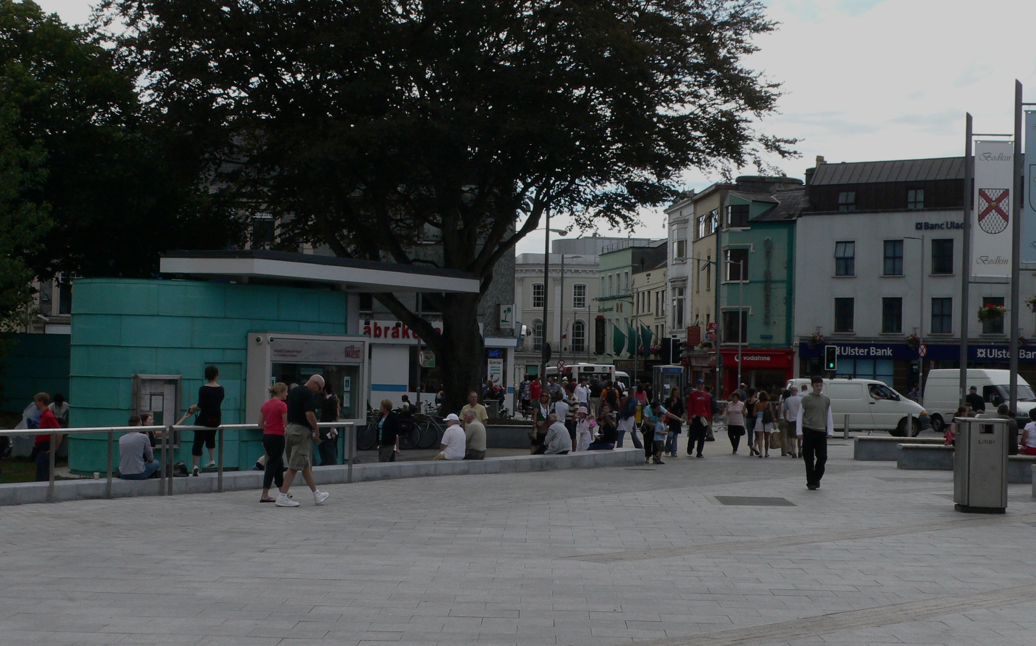
VITALITY + VIABILITY
“The concept of vitality and viability
is central to maintaining healthy town centres.
It depends on many factors including…
accessibility, uses, amenity, appearance and safety.
Healthy towns balance a number of these.”
(DoE Retail Planning Guidelines)

Slide 4
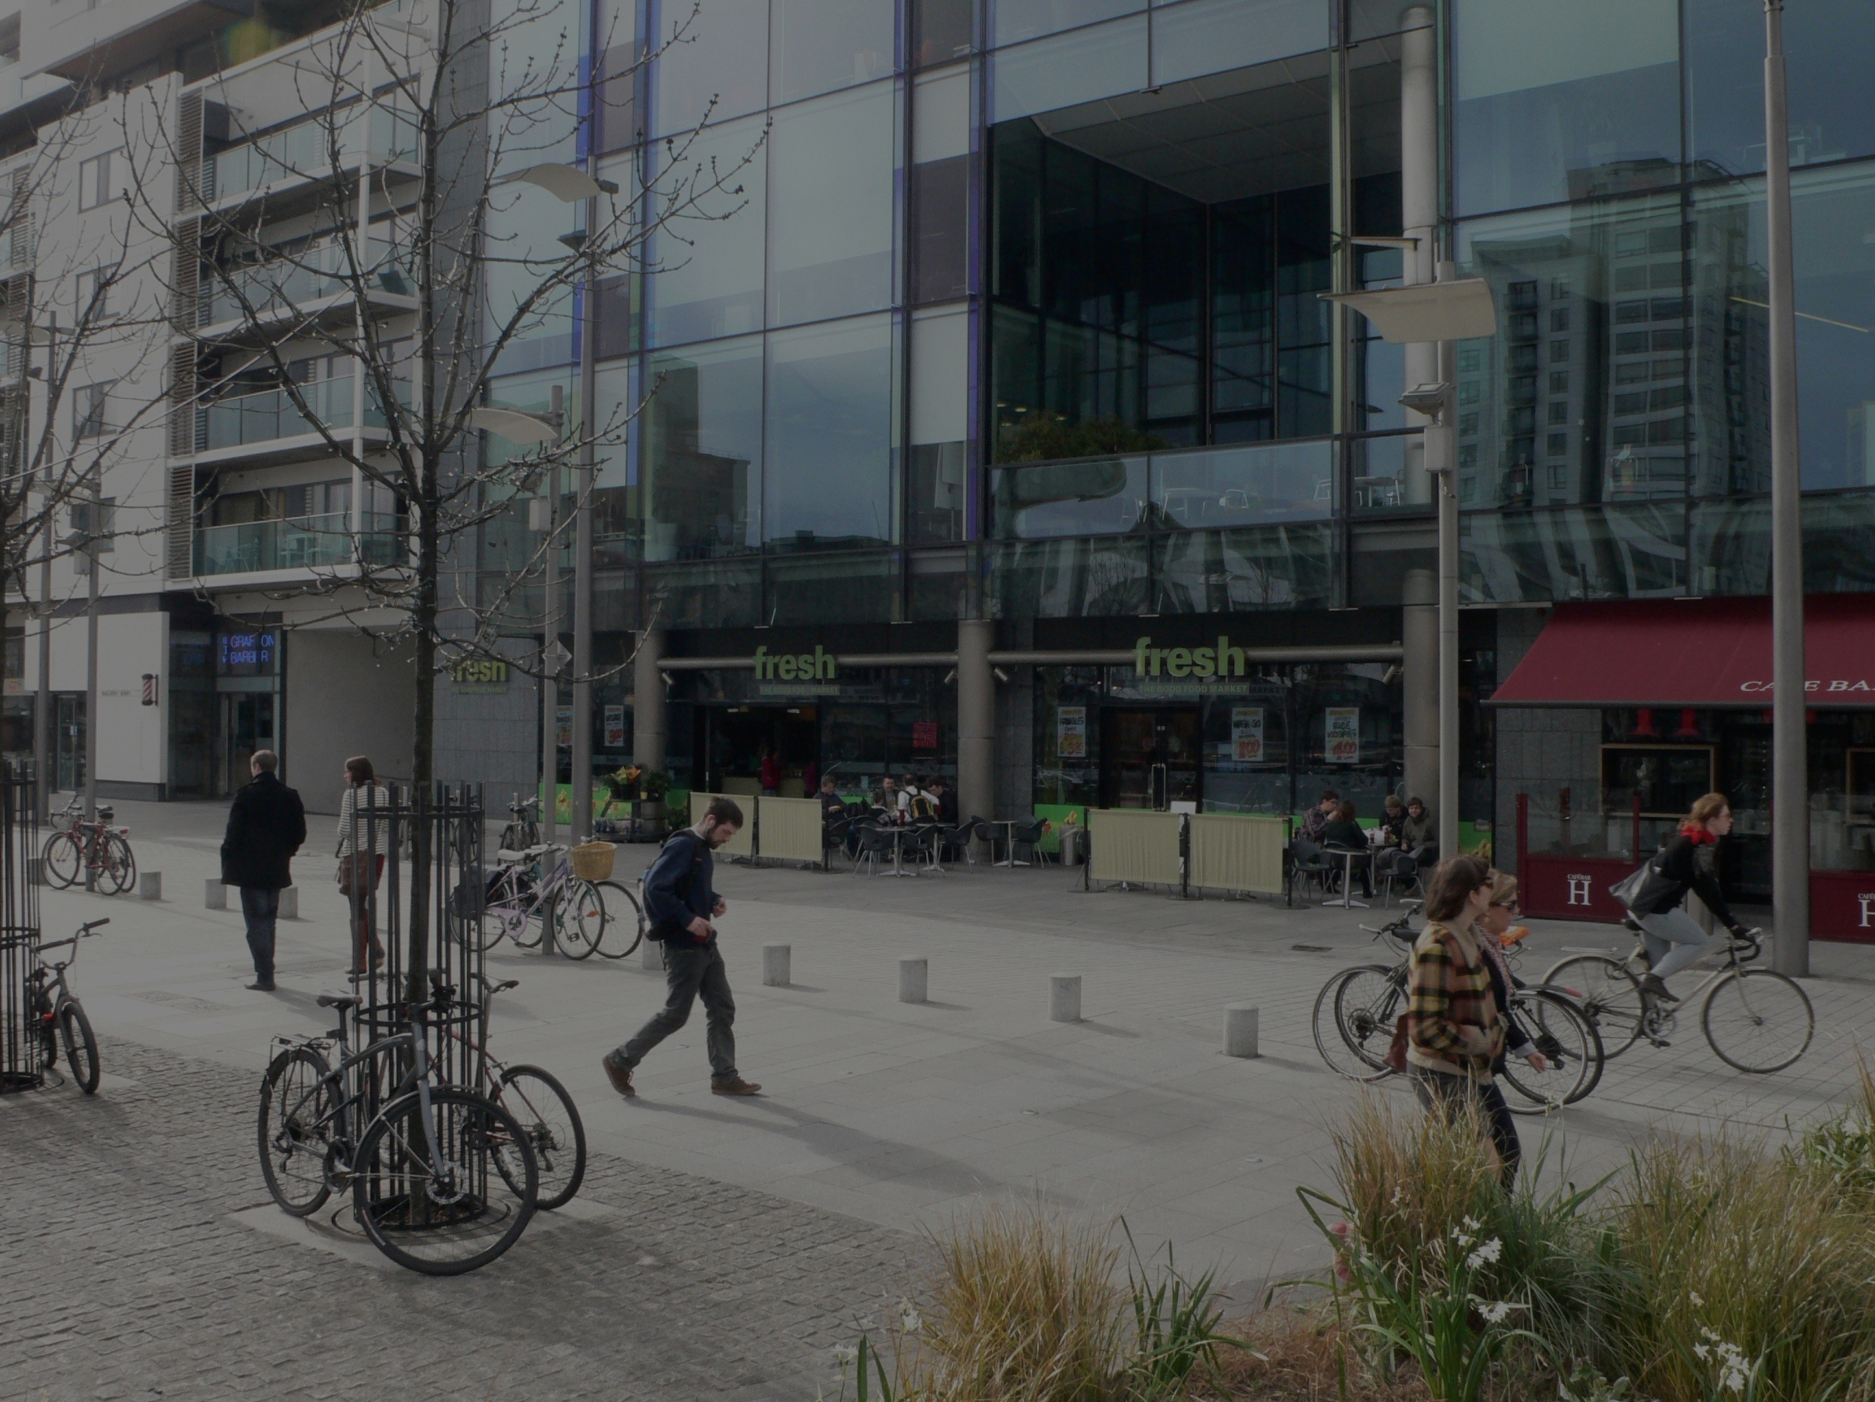
VITALITY + VIABILITY
“84% of people wish to live in a small village.
We cannot create enough villages for this aspiration.
Cities must be desirable places to live in and be in…
belonging, continuity, predictability, safety…
and much more…
a sense of place, trade, delight and ‘buzz’.”
(Charles Landry)

Slide 5
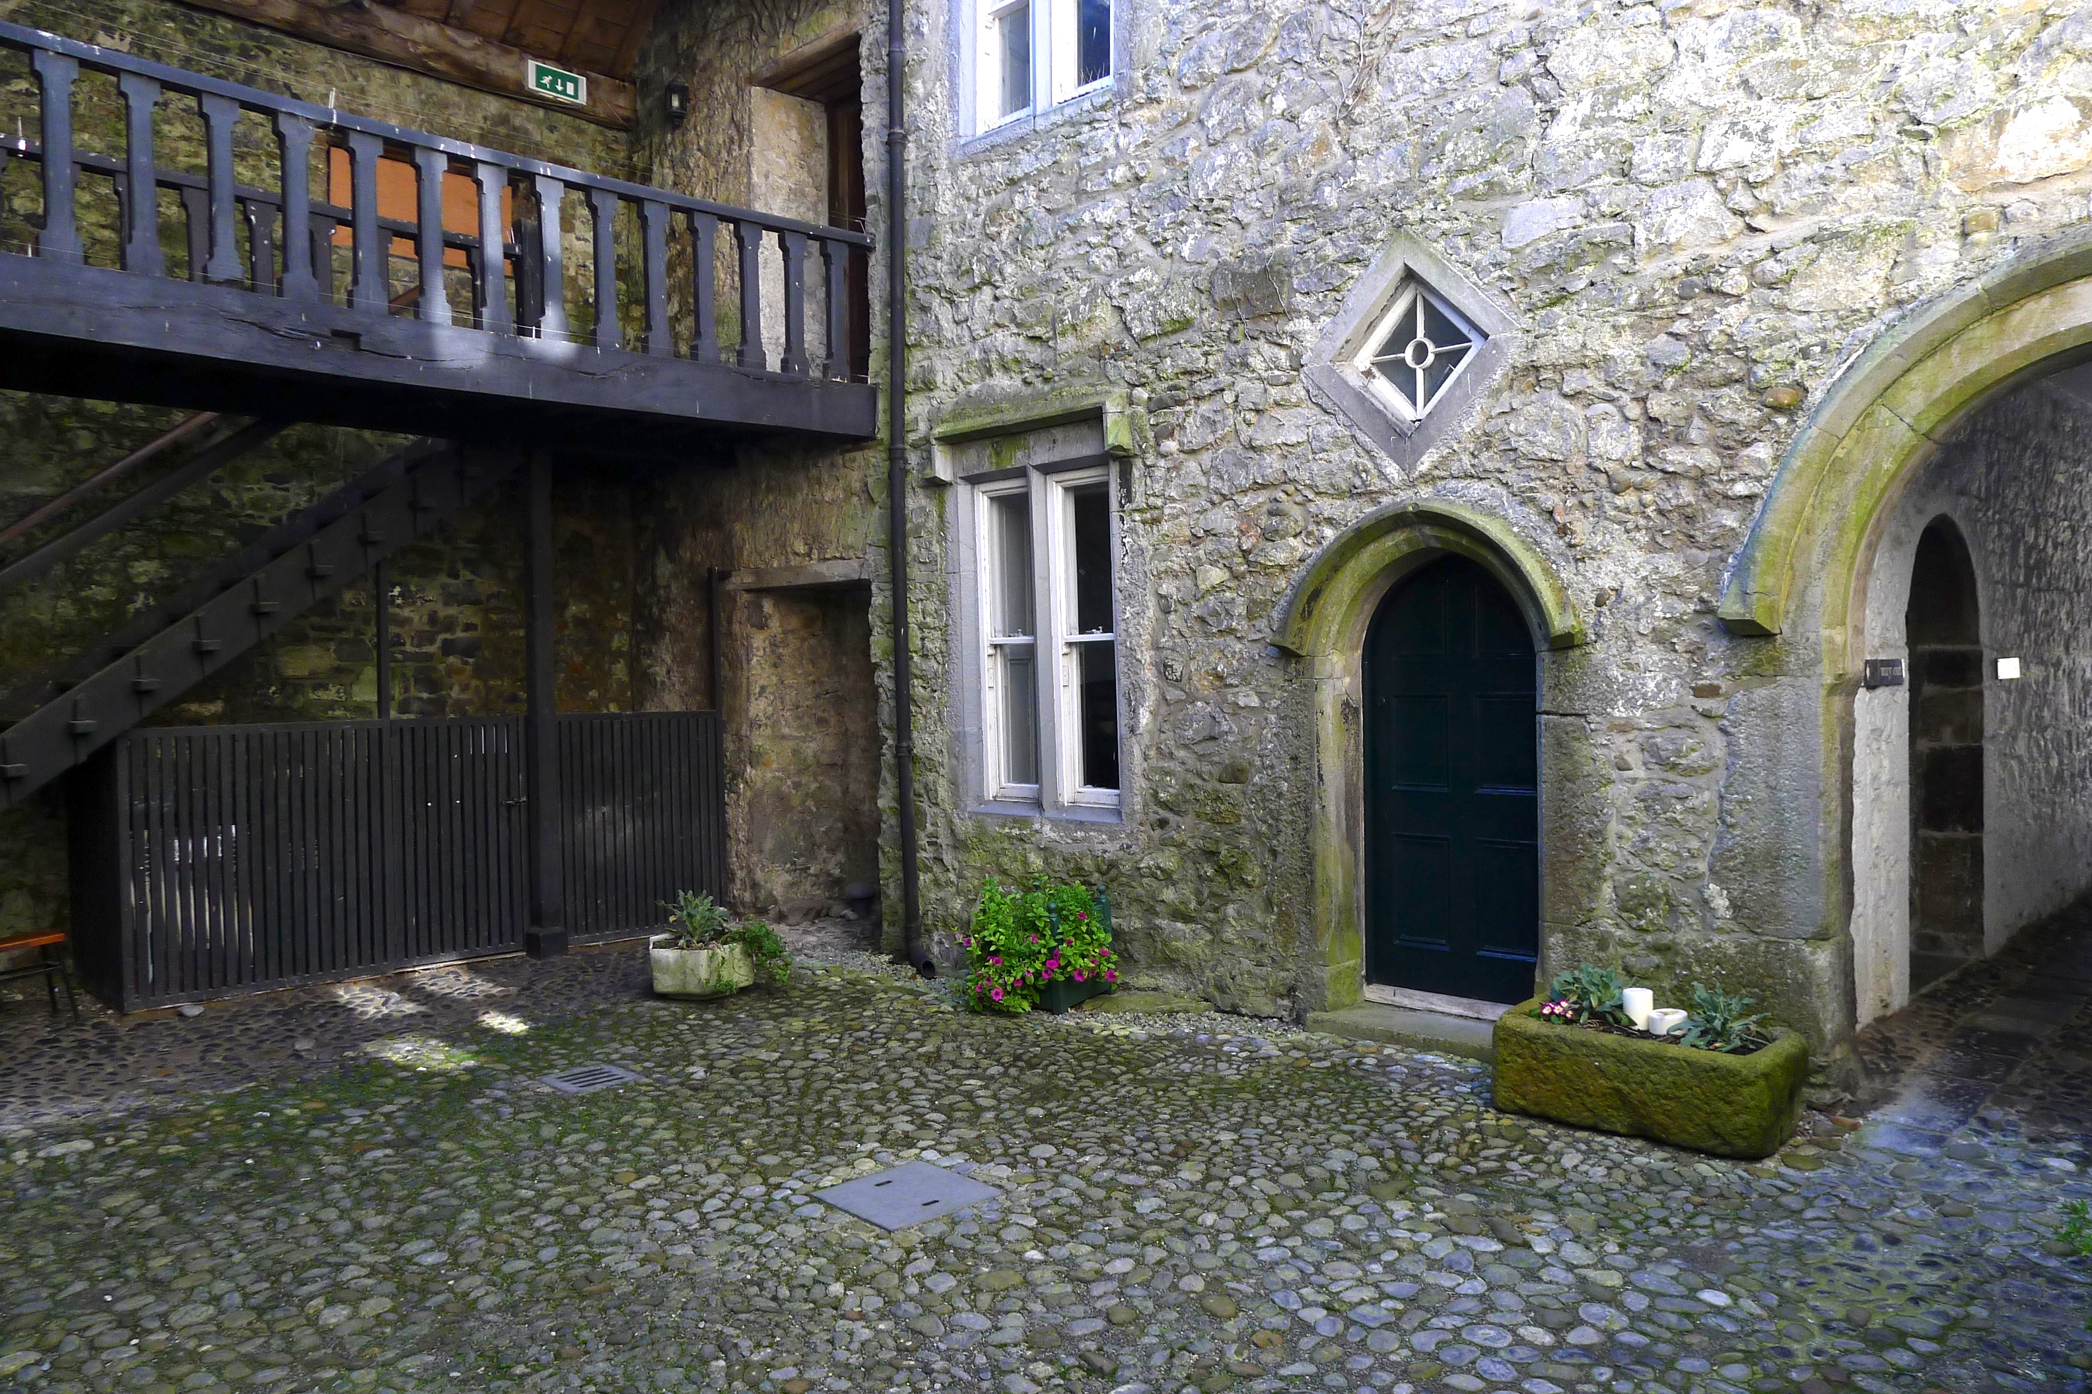
CONTEXT + CHARACTER
“Designers should carry out an appraisal of
the distinctive character of the area…
and consider how the design and layout
responds to and preferably enriches that character.”
( DoE Retail Planning Guidelines)

Slide 7
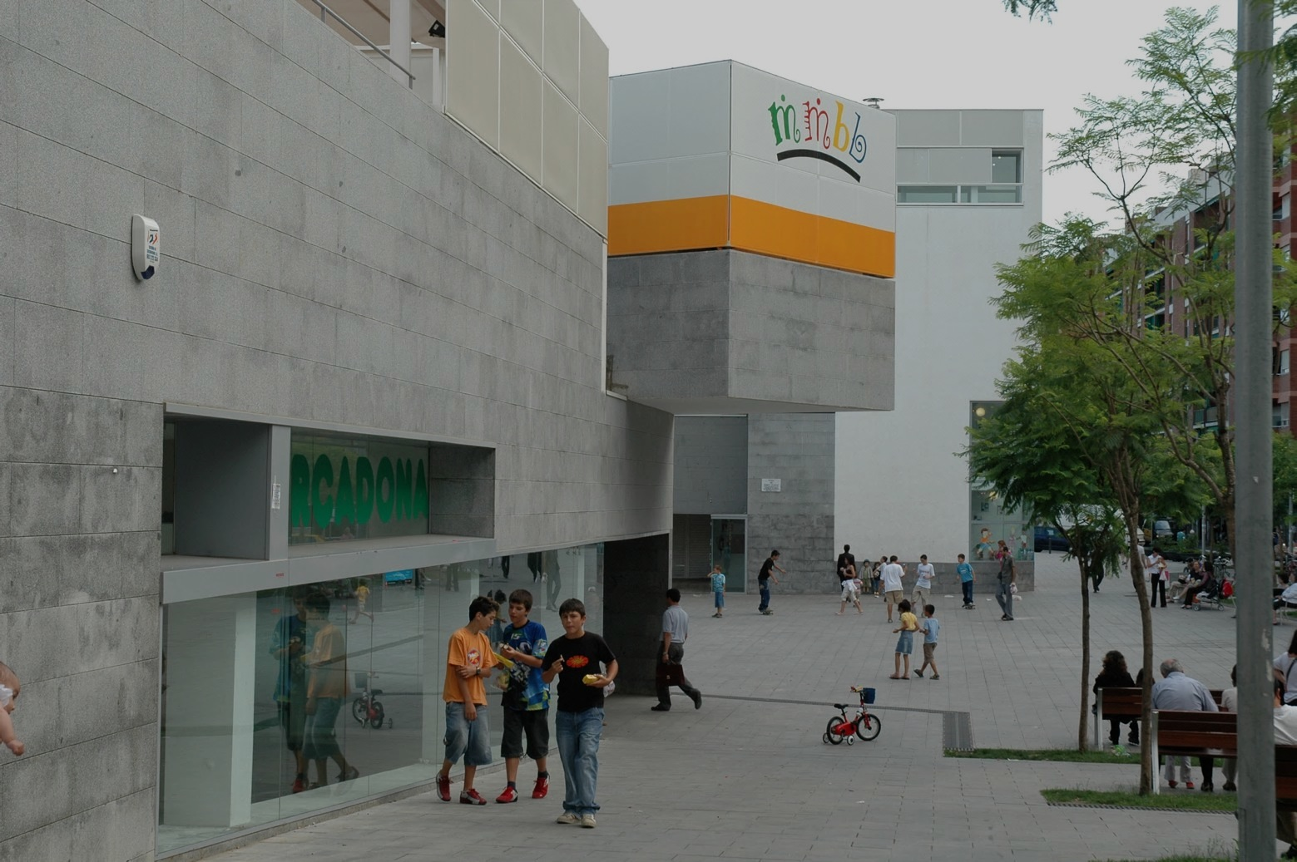
  PUBLIC REALM
“Barcelona sought her future
by improvement of her urban quality…
the trick was quality first and quality second…
A network of plazas, parks and buildings
was the cause of our success.”
(Mayor Pasqual Maragall)

Slide 8
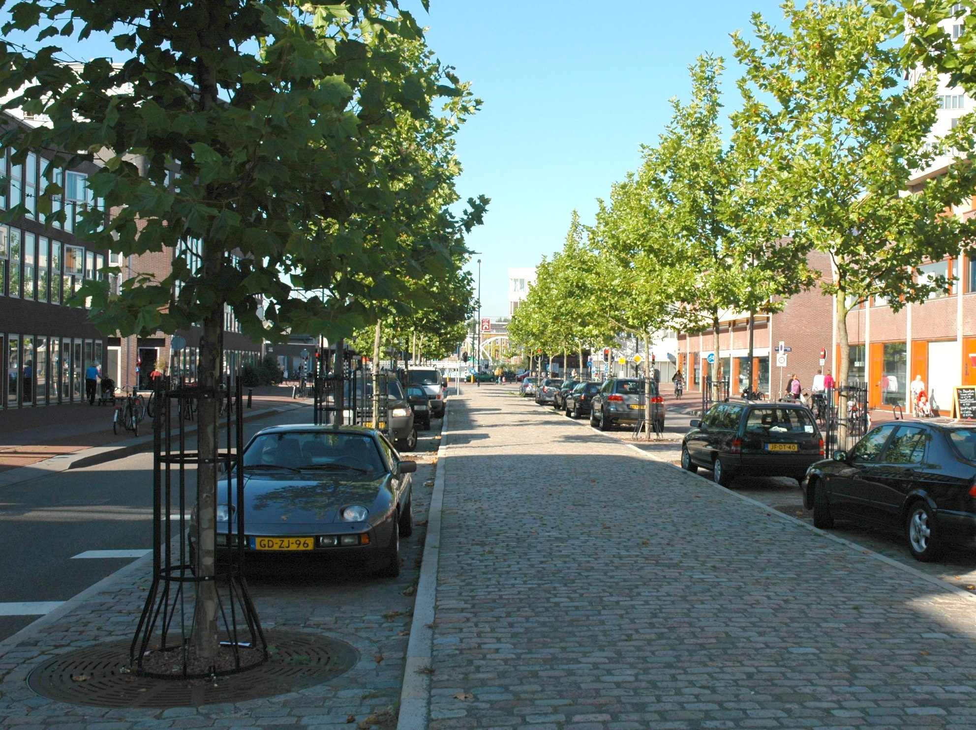
URBAN STRUCTURE
“For most of human history, streets
accommodated the full range of human activity…
socialising, play, meetings, entertainment, protest
and social change.
They were also the routes for travel
and movement of goods.
Today that balance is lost.”
(Living Streets Manifesto)

Slide 9
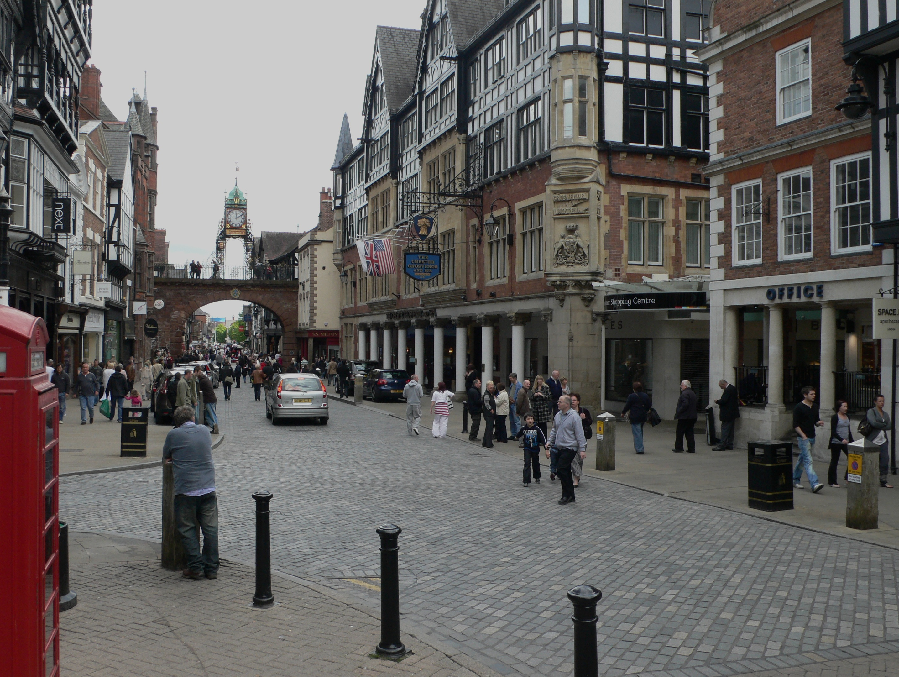
  ACCESS AND CONNECTIVITY
“City and town centres
that are accessible and well-connected..
easy to get to and move about…
by sustainable travel modes…
balancing the needs of cars, cyclists pedestrians.”
(Retail Design Guidelines)

Slide 10
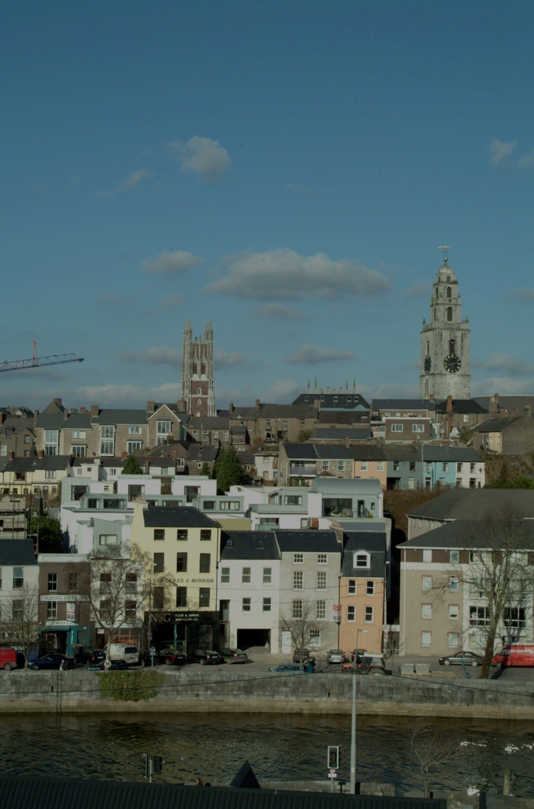
LAND USE + DENSITY
“Ireland needs to renew, consolidate and develop
its existing cities, towns and villages…
keeping them as physically compact as possible…
minimising urban sprawl…..
and achieving a high quality of design.”
(National Spatial Strategy)

Slide 11
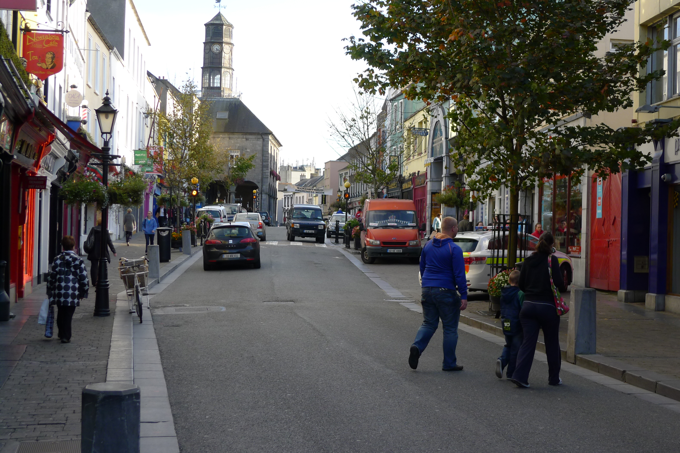
MIXED USE
“The district
must serve more than one primary function…
preferably more than two.
The presence of people on different schedules
in the place for different purposes
and able to use many facilities in common.”
(Jane Jacobs)

Slide 12
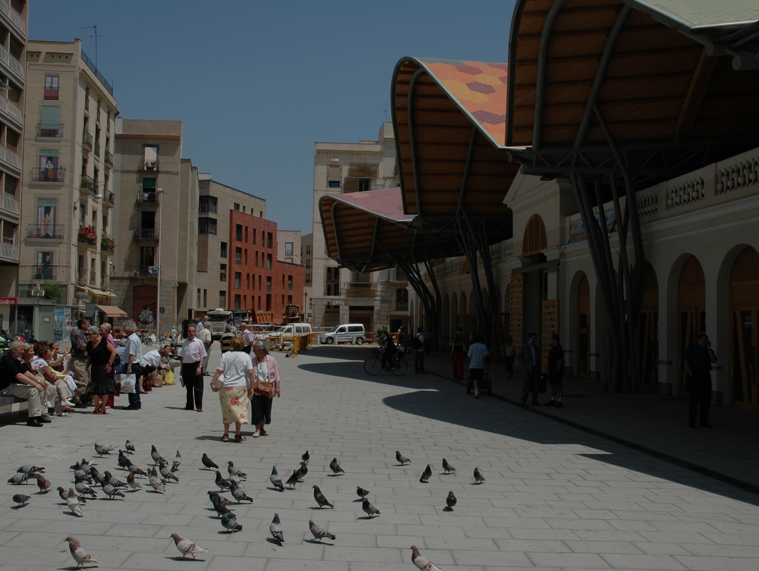
BUILT FORM
“New work should be sympathetic
in scale and character…
and at least as good an example
of contemporary design
as the older work was of its own period.”
(Royal Fine Art Commission)

Slide 13
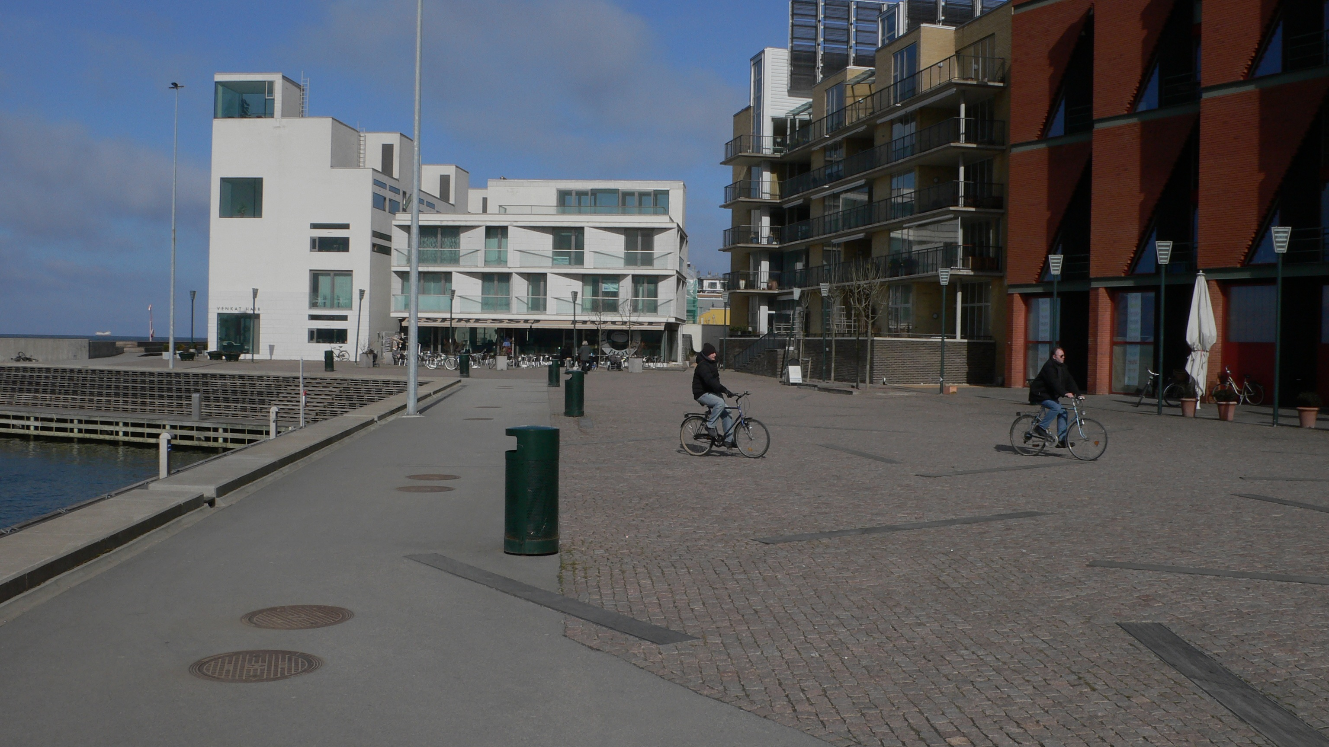
  SUSTAINABLE DEVELOPMENT
“A sustainable and ecologically robust
urban community:
resource-efficient construction…
renewable energy sources…
water and waste management…
alternative forms of transport.”
(Bo10 City of Tomorrow, Malmo)

Slide 14
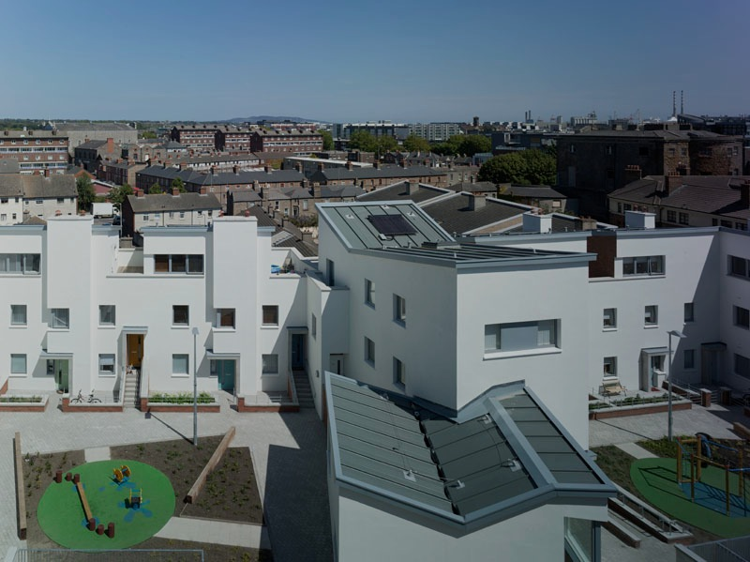
“Climate change
is one of the greatest challenges facing mankind...
The ‘Compact City’ model
increases energy efficiency…
consumes less resources…
produces less pollution…
avoids urban sprawl.”
ENVIRONMENTAL RESPONSIBILITY
(Urban Task Force / Richard Rogers)

Slide 15
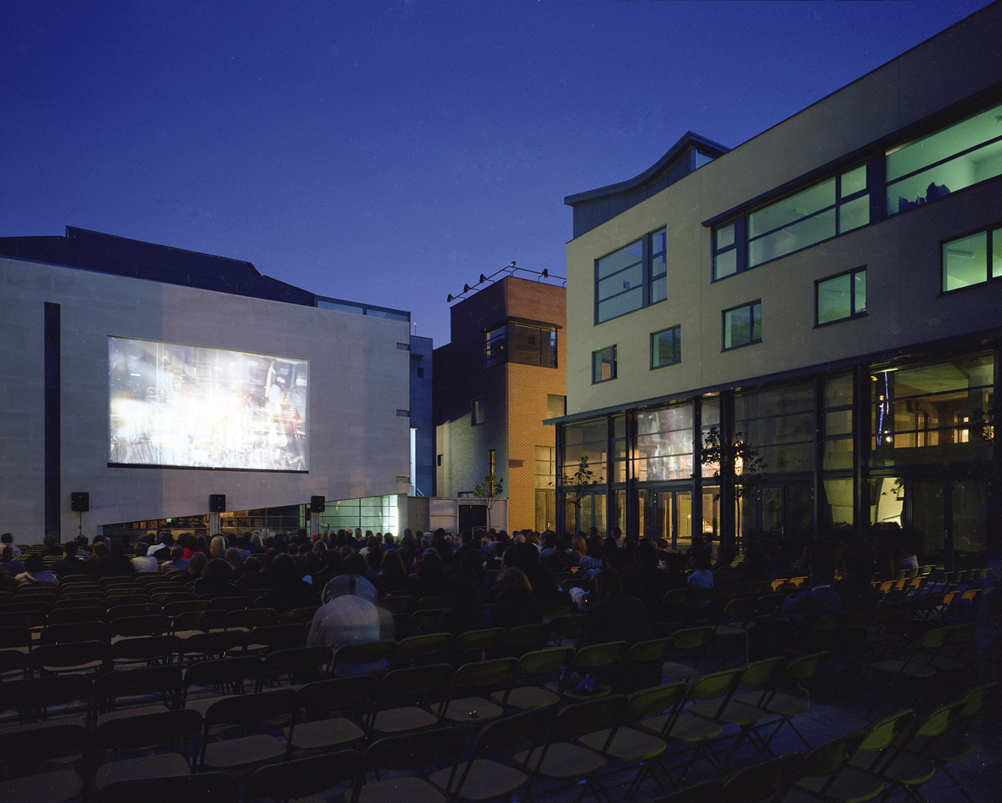
“High levels of design euality…
contribute to:
attractive and sustainable built environments…
distinctive culture and heritage…
national and local economic competitiveness..
improved quality of life for people…
the ‘Heritage of Tomorrow’.”
DESIGN QUALITY
(RIAI Strategic Review)

Slide 16
CONCLUSION
“When we build…
let us imagine that we build forever.”
(John Ruskin)

Slide 17
